Slide 1
PROJECT
searchBay
Web search engine
PRESENTED BY
Akash Sen
Anubhuti Deshmukh
Aswin Suresh
Ashutosh Kumar Soni
Ayaan Ahmed
GUIDED BY
Mr. Prageet Bajpai
Project link
www.github.com/2207akash/searchbay

Slide 2
Index:
Product Features
Hardware/Software Requirements
Technologies used
The web crawler
Ideology / working
Scope of work in future
References

Slide 3
Introduction / Product features:
This application can be used to search through the web for information (including text, links, images or videos) on a particular term
Stores the content links such as website URLs, images and text into the database by recursively crawling through websites
Supports textual web search
Uses regular expressions to find the patterns in the search
Ranks web pages on the basis of most visited websites
Flexible and easy to use interface
Supports tab feature for people with vision/sight issues

Slide 4





Hardware / Software requirements:
OS:
Windows 7 (or above)
Linux
Browser:
Google Chrome
Microsoft Edge
Internet Explorer 8 (or above)
Mozilla Firefox

Slide 5






Technologies used:
Frontend:
HTML
CSS
JS
Backend:
PHP
Other tools/technologies:
AJAX
jQuery
MySQL

Slide 6
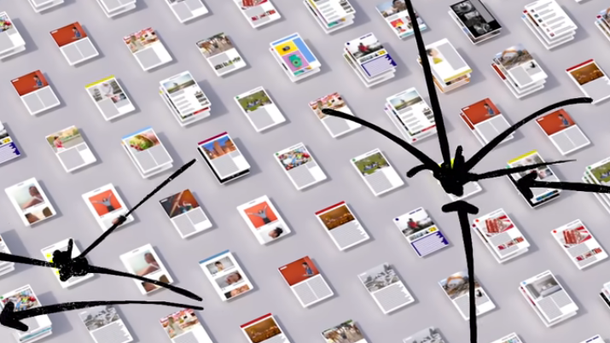
Role of Web crawler:
Recursively search for web links and data relevant to the user’s search and catch up all images, videos and related links to the database.
Here’s a little sight to demonstrate what the web crawler does

Slide 7
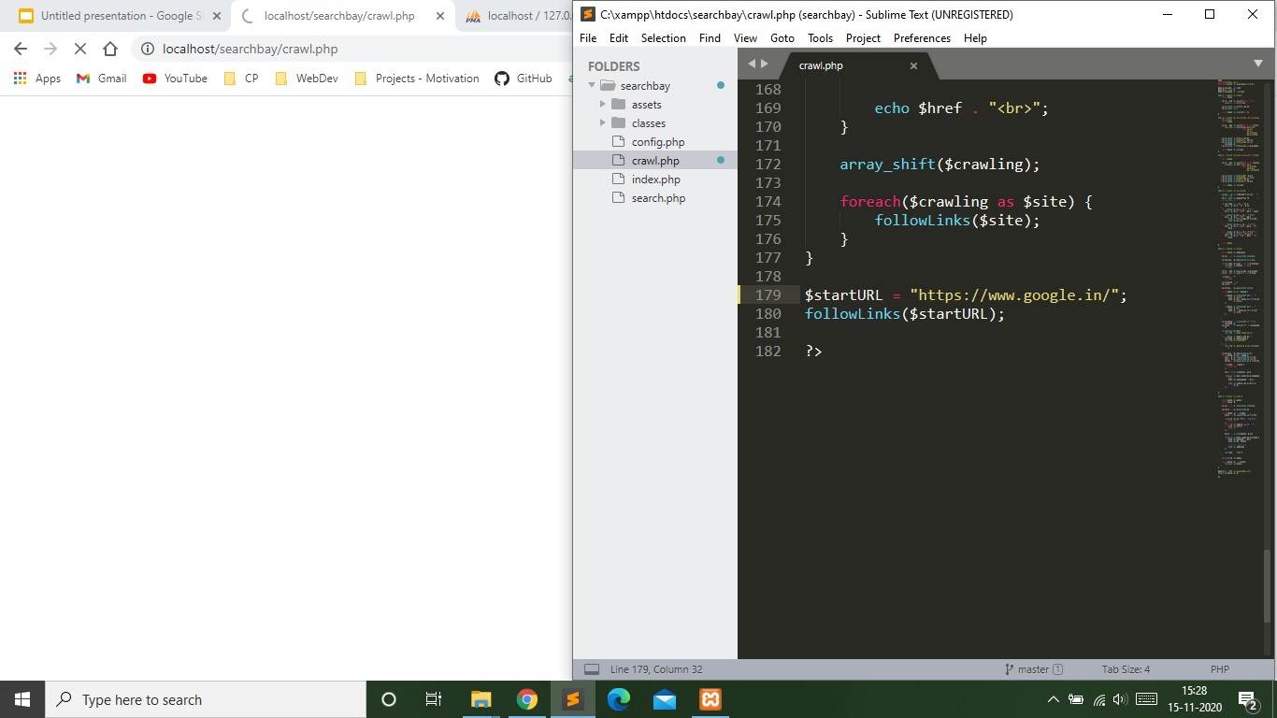

Slide 8
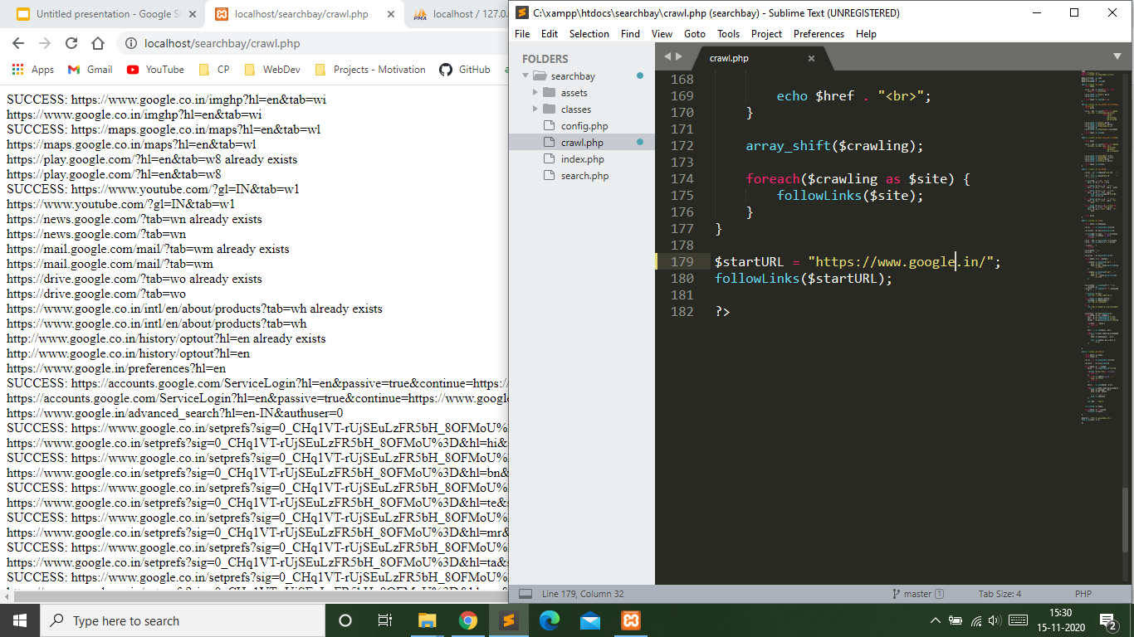

Slide 9
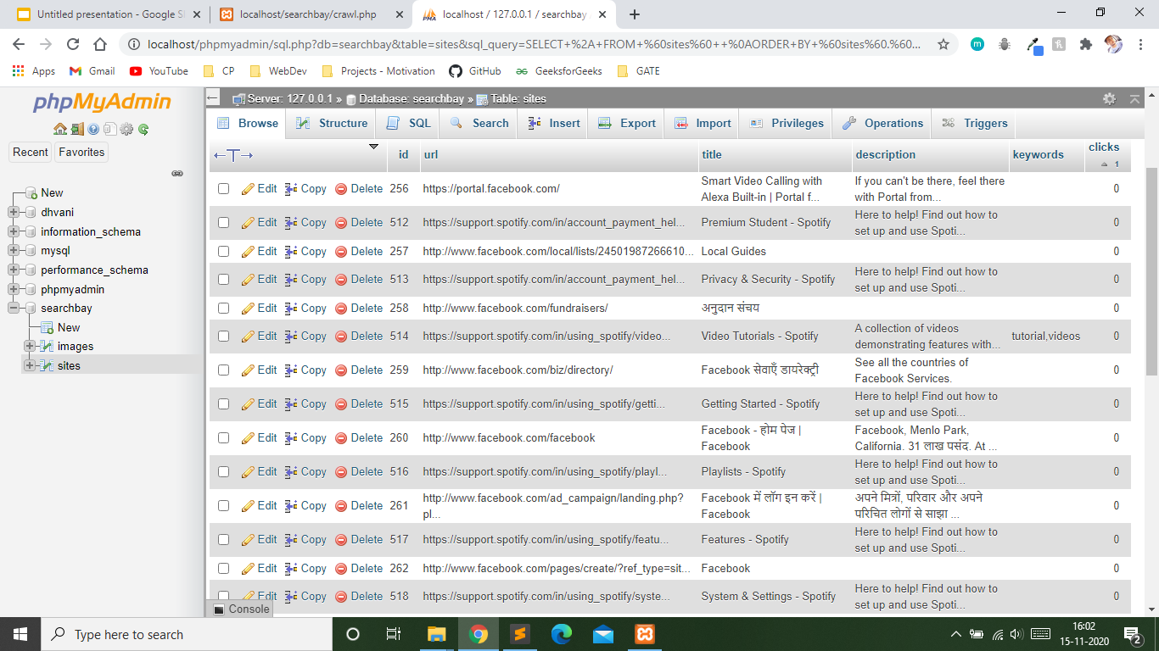

Slide 10
WORKING IN A NUTSHELL
The HTML document is parsed and corresponding links are fetched by hunting down all the HTML tags that are either image, video, or a simple link.
Tags like <title>, <description>, <img>, <video> are looked up and stored in the database so as to display the results when required. The web crawler recursively keeps on parsing the website until all the links have been parsed and copied to the database.
AJAX is used to dynamically update the webpage without refreshing.
Each time a link is clicked, the database needs to be updated in-order to put that page into higher ranking of search result.
Results of search query are finally displayed in decreasing order of ranking.

Slide 11
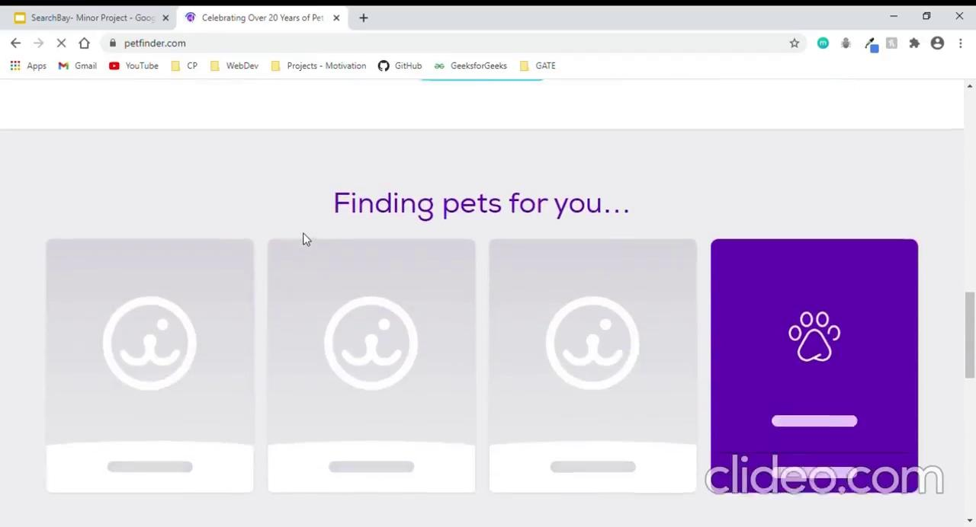
PROJECT SAMPLE

Slide 12
Scope of work in future:
The ranking of the web pages could be made effective with the help of technologies like ML and AI, which would highly improve the ranking of web pages to deliver the requirements of the user.
The user interface can be made more interactive.
May use voice recognition to add feature like ‘searching by voice’.
May add optional search patterns in the beginning of query to search for specific type of content that the user wants to search for.
E.g Query: site::google
This should search for all content that contain “google” as a term in the query and are of type website (excluding image/video links)

Slide 13
References:
How Google search works?
https://www.google.com/search/howsearchworks/
https://www.youtube.com/watch?v=0eKVizvYSUQ
Stackoverflow
https://stackoverflow.com/questions/5834808/designing-a-web-crawler
Github/google
https://github.com/google/cityhash
THANK YOU

